Slide 1
A Meterial Design Study App
Team Members:
Tamizhmaran
Rajesh
Priyanga
Anbumani

Slide 2
Introduction
Brief description of the app as a comprehensive tool for efficient studying, personalized learning, and academic growth.
Purpose: Helping students streamline their study process, stay organized, and improve knowledge retention.

Slide 3
Problem Statement
Challenges Students Face: Address issues like time management, organization, and motivation that hinder effective studying.
Solution: An all-in-one app to help students organize study material, track progress, and stay engaged.

Slide 4
Key Features
Smart Planner – Schedule study sessions, set reminders, and organize tasks to manage time effectively.
Quizzes & Flashcards – Reinforce learning through customized quizzes and flashcards.
Progress Tracking – Monitor study time, productivity, and improvement.
Resource Library – Access a variety of study resources like notes, videos, and guides.
Collaborative Tools – Share notes, study in groups, and participate in discussions.

Slide 5
Onboarding Screens
Seamless Onboarding: Friendly walkthrough of the app’s key features and functionalities to familiarize users upon sign-up.
User Benefit: Helps users quickly understand the app’s layout and features.

Slide 6
Registration & Sign-In
User Authentication: Secure sign-up and sign-in using email, phone, or social media accounts.
User Benefit: Provides quick access to personalized study settings and data.

Slide 7
Smart Study Planner
Planning and Scheduling: Organize tasks, set reminders, and track study goals.
User Benefit: Aids in consistent studying and effective time management.

Slide 8
Personalized Quizzes & Flashcards
Customizable Quizzes: Tailor quizzes to specific subjects or topics to reinforce learning.
Flashcards: Create and review flashcards for quick knowledge checks.
User Benefit: Engaging, interactive tools to improve memory retention.

Slide 9
Progress Tracking
Tracking Dashboard: Visual insights into study hours, topic coverage, and improvement over time.
User Benefit: Keeps users motivated by showing progress and identifying strengths/weaknesses.

Slide 10
Resource Library
Study Resources: Access notes, tutorial videos, and articles organized by subject and difficulty level.
User Benefit: Supports self-paced learning with easily accessible study materials.

Slide 11
Goal Setting and Rewards
Goals and Milestones: Set study goals and unlock rewards to stay motivated.
User Benefit: Encourages consistent study habits through gamification and rewards.

Slide 12
Kotlin Implementation Dependencies in
dependencies {
implementation 'com.google.android.material:material:1.9.0' // Update as needed
implementation 'androidx.appcompat:appcompat:1.6.1'
implementation 'androidx.constraintlayout:constraintlayout:2.1.4'
implementation 'androidx.navigation:navigation-fragment-ktx:2.6.0'

Slide 13
implementation 'androidx.navigation:navigation-ui-ktx:2.6.0'
}

Slide 14
MainActivity.kt:
package com.example.materialstudyapp
import android.os.Bundle
import androidx.appcompat.app.AppCompatActivity
import androidx.navigation.findNavController
import androidx.navigation.ui.setupActionBarWithNavController
import androidx.navigation.ui.setupWithNavController

Slide 15
import com.example.materialstudyapp.databinding.ActivityMainBinding
import com.google.android.material.snackbar.Snackbar
class MainActivity : AppCompatActivity() {
private lateinit var binding: ActivityMainBinding
override fun onCreate(savedInstanceState: Bundle?) {

Slide 16
super.onCreate(savedInstanceState)
binding = ActivityMainBinding.inflate(layoutInflater)
setContentView(binding.root)
// Set up navigation
val navController = findNavController(R.id.nav_host_fragment)
setupActionBarWithNavController(navController)

Slide 17
binding.bottomNavigationView.setupWithNavController(navController)
// Set up FAB
binding.fab.setOnClickListener {
Snackbar.make(it, "FAB clicked!", Snackbar.LENGTH_SHORT).show()
}
}
}

Slide 18
Java Implementation MainActivity.java:
package com.example.materialstudyapp;
import android.os.Bundle;
import android.view.View;
import androidx.appcompat.app.AppCompatActivity;
import androidx.navigation.NavController;
import androidx.navigation.Navigation;
import androidx.navigation.ui.AppBarConfiguration;
import androidx.navigation.ui.NavigationUI;

Slide 19
import com.example.materialstudyapp.databinding.ActivityMainBinding;
import com.google.android.material.snackbar.Snackbar;
public class MainActivity extends AppCompatActivity {
private ActivityMainBinding binding;

Slide 20
@Override
protected void onCreate(Bundle savedInstanceState) {
super.onCreate(savedInstanceState);
binding = ActivityMainBinding.inflate(getLayoutInflater());
setContentView(binding.getRoot());
// Set up navigation

Slide 21
NavController navController = Navigation.findNavController(this, R.id.nav_host_fragment);
AppBarConfiguration appBarConfiguration = new AppBarConfiguration.Builder(
R.id.homeFragment, R.id.settingsFragment).build();
NavigationUI.setupActionBarWithNavController(this, navController, appBarConfiguration);

Slide 22
NavigationUI.setupWithNavController(binding.bottomNavigationView, navController);
// Set up FAB
binding.fab.setOnClickListener(new View.OnClickListener() {
@Override
public void onClick(View view) {

Slide 23
Snackbar.make(view, "FAB clicked!", Snackbar.LENGTH_SHORT).show();
}
});
}
}

Slide 24
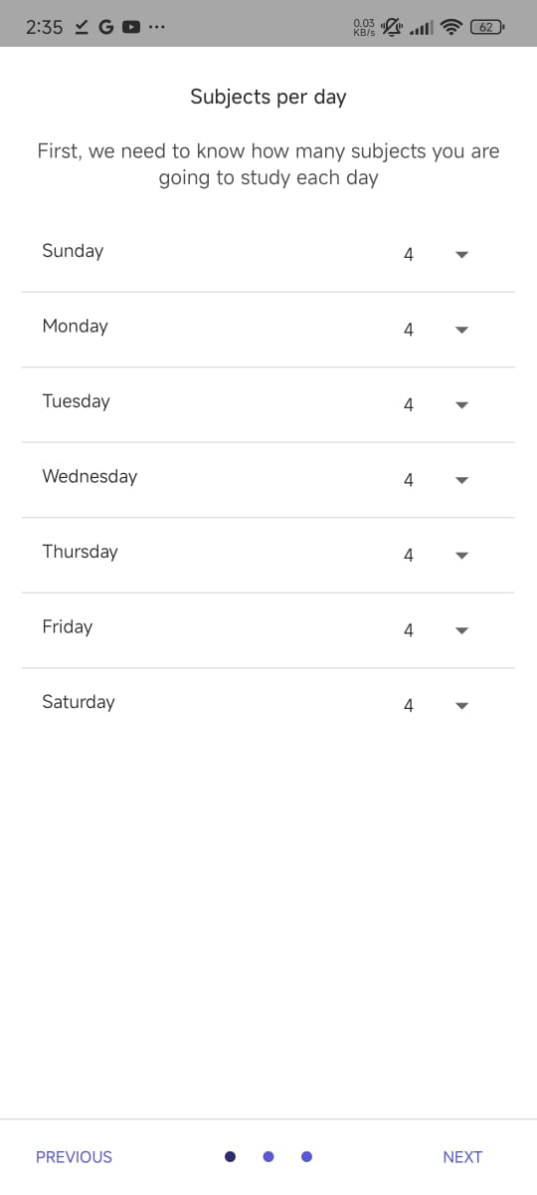
OUTPUT:

Slide 25
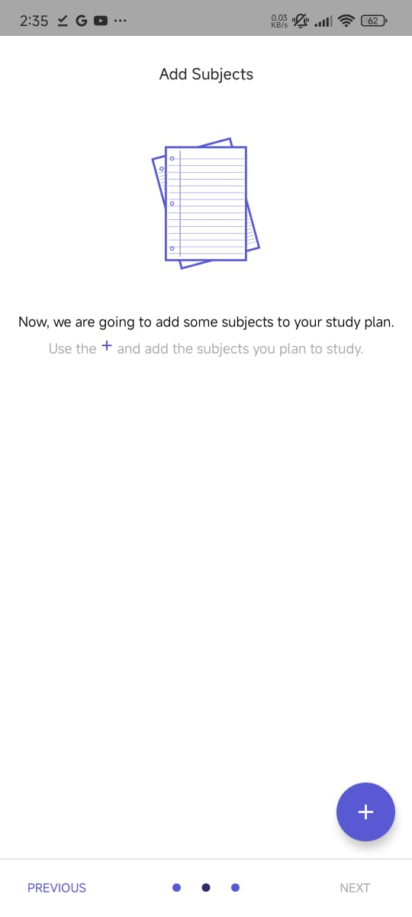

Slide 26
